Slide 1
Week 6: Graph Algorithms Continued; Greedy Algorithms
CS 5800
Dr. Alan Jamieson

Slide 2
What’re we talking about today, Alan?
Subset parameter optimization
Matchings
Domination
Specifying Greedy Algorithms
Minimum Spanning Tree

Slide 3
Shifting gears: subset parameters
Sometimes we want to create a subset of vertices or edges that follow some kind of pattern - these are called subset parameters.
These patterns can be thought of as restrictions.
For instance: every vertex in my subset can’t be adjacent to another vertex in my subset.
A lot of these are simple to state and conceptualize, but very difficult from an algorithmic perspective.

Slide 4
Matching
Formally: S ⊆ E s.t. ∀s ∈ S, N(s) ∩ S = ∅.
N(s) is defined as the open neighborhood of s. When dealing with edges, these are all of the edges that share a vertex with s. Open in this context means that it does not include s itself.
Basically - a subset of edges s.t. no two edges are next to each other.
This is what is called a “maximal” parameter - I’m trying to jam as many edges into S as possible.

Slide 5
Quick note on maximum/maximal
Maximal means that I have a set that I cannot add anything to. This may not be the largest such set!
Maximum is the largest maximal set.
As you’d expect, minimum/minimal is a thing as well.

Slide 6
Example:
JAMMY JAM TIME

Slide 7
Algorithm?
Maximum?
Maximal?
NOW YOU DECIDE!
In your groups, come up with a greedy strategy to get a maximal matching for an arbitrary graph that gets close-ish to optimal.

Slide 8
One more: domination.
Formally - S ⊆ V s.t. ∀s ∈ V-S, |N(s) ∩ S| > 0.
Basically - every vertex not in the subset is adjacent to at least one vertex in the subset.
Lots of variations here, and quite a few applications (think resource management).

Slide 9
Example:
J?

Slide 10
Algorithm?
Minimum?
Minimal?
NOW YOU DECIDE!
In your groups, come up with a greedy strategy to get a minimal dominating set for an arbitrary graph that gets close-ish to optimal.

Slide 11
Looping back to greedy:
Recap:
Build a solution piece by piece.
At each “decision” point, choose the best piece (i.e. the piece that gets us closest to the solution)
Do not allow for backtracking.
Does not guarantee optimality, but is typically very fast.

Slide 12
Goddard’s Definition:
The elements of a greedy algorithm are:
1. A set C of candidates
2. A set S of selected items
3. A solution check: does the set S provide a solution to the problem (ignoring questions of optimality)?
4. A feasibility check: can the set S be extended to a solution to the problem?
5. A select function which evaluates the items in C
6. An objective function

Slide 13
Coin changing problem
How do you make change in the US with the minimum number of coins (1c, 2c, 5c, 10c, 25c, 50c)?

Slide 14
Coin changing problem
How do you make change in the US with the minimum number of coins (1c, 2c, 5c, 10c, 25c, 50c)?
Candidates - infinite collection of coins, C Selection - a subset S ⊆ C of the candidate coins Solution check - Does S add up to our target value? Feasibility check - Does adding c ∈ C total to more than required? Select function - value of the coin Objective function - number of coins

Slide 15
Now you:
Consider our two earlier problems: minimal dominating set and maximal matching. Specify these two problems using the greedy algorithm definition elements from Goddard.
Breakout rooms: when completed, send me a slack message.

Slide 16
Our first problem:
One of the things that we get by using DFS is a spanning tree
Spanning tree: subset of edges of an undirected, connected graph that, when induced, creates an acyclic graph that includes all vertices in that graph.
Minimum Spanning Tree (MST): given a connected, weighted, undirected graph, what’s the smallest (by edge-weight sum) spanning tree?

Slide 17
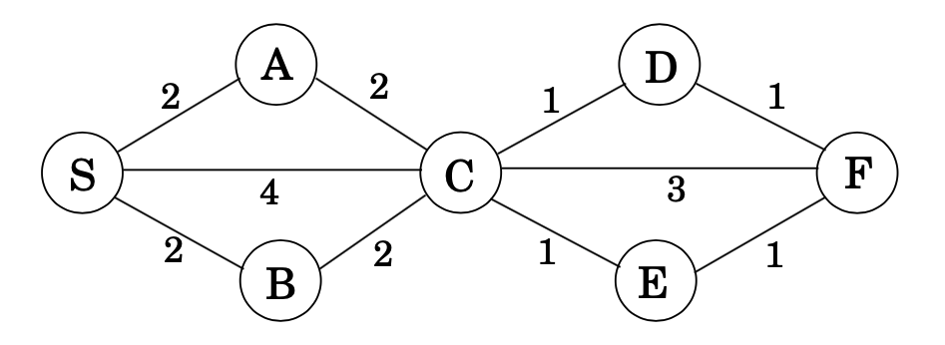
Example:
Credit: Dasgupta, problem 4.18

Slide 18
Specification:
Candidates - edges Selection - a subset S⊆ E of the candidate edges Solution check - does S touch every vertex, is it connected? Feasibility check - does adding e ∈ E create a cycle? Select function - edge weight Objective function - sum of weights

Slide 19
A simple greedy approach:
Assume the graph is “correct” meaning weighted, undirected, and connected.
Just choose the edges with the smallest weight that do not create a cycle!

Slide 20
Example:
Credit: Dasgupta, problem 4.18

Slide 21
A simple greedy approach:
Assume the graph is “correct” meaning weighted, undirected, and connected.
Just choose the edges with the smallest weight that do not create a cycle!
Does this guarantee optimality? How long does this take?

Slide 22
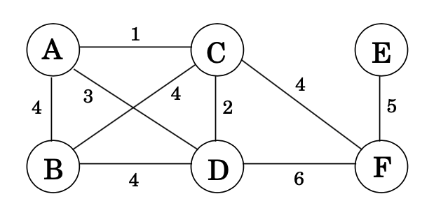
Now you:
Using the simple greedy approach, find the MST of the graph below:
Breakout rooms: when completed, send me a slack message.
Figure credit: Dasgupta, 5.1

Slide 23
Synthesis Q&A

Slide 24
On your radar:
Homework #5: due tomorrow (October 15)
Synthesis #1: due October 22nd
Reading: still Chapter 5

